Slide 1
Introduction

Slide 2
Introduction should...
Give background on the subject
  First paragraph → broad background
  Second paragraph → specific background
State the unknowns and why they should be studied (third paragraph)
Briefly state what you did (fourth paragraph).

Slide 3
Paragraphs 1 & 2
Start by briefly discussing the importance of your chosen treatment to freshwater life in general (paragraph 1),
then provide information about the specific organism used in the lab (Daphnia magna) (paragraph 2).

Slide 4
Paragraph 3
For paragraph 3:
  What is known about Daphnia magna and your chosen treatment? What do similar studies show? What is not known?
  What do you think will happen?
    Hypothesis OR
    Null hypothesis OR
    Prediction.

Slide 5
Paragraph 4
For paragraph 4:
  What did you do in your experiment?
  How did you do it (briefly)?
  Why did you do it (one sentence)?

Slide 6
Tense
Introduction can be in present tense unless referring to your experiment
All references to your experiment (Intro, Methods, Results, Conclusion) are in past tense!

Slide 7
Who did the study?
You didn’t (unless you had no help at all)
Your group did
  “We”, “Our”.

Slide 8
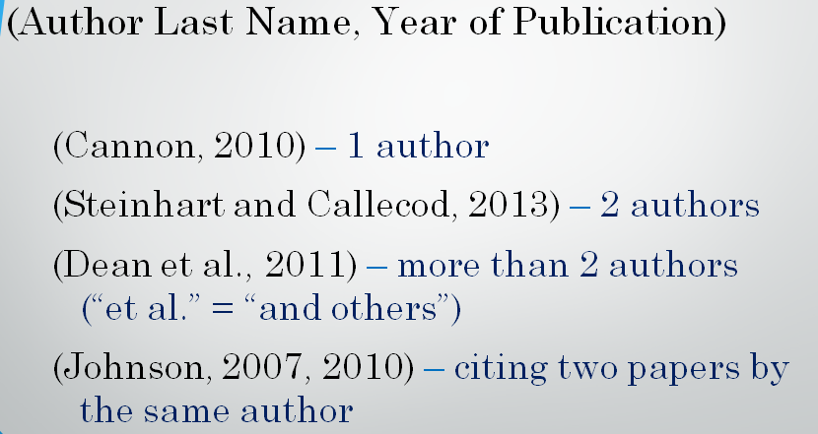
Internal citations
Remember that all background information must be internally cited!
I want at least one complex citation.

Slide 9
Internal citations
You must possess at least 5 sources, 3 of which must be primary sources.

Slide 10
Conducting a Literature Search

Slide 11
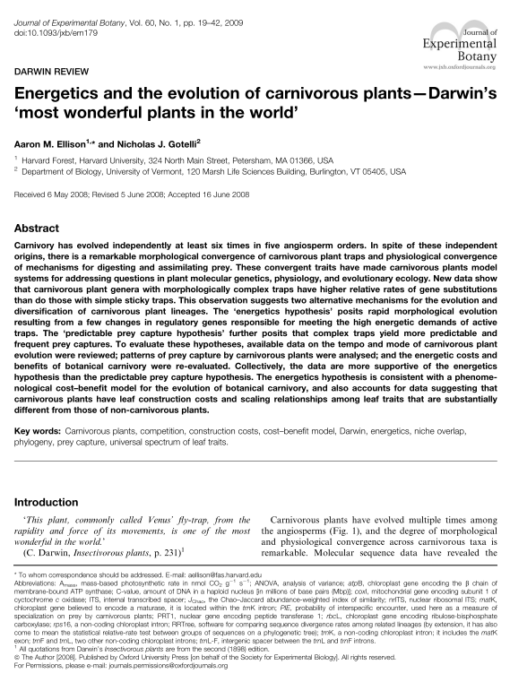
Types of sources
Primary source – article written by a scientist (his/her original work)
  Ex: journal article,
  PhD dissertation, MS thesis
  Primary audience: Other
  scientists and scholars
  Purpose: Allow others to
  duplicate, build upon, or
  respond to his/her work.

Slide 12

Types of sources
Secondary source – sources that discuss primary sources (not original research)
  Examples: books,
  textbooks, newspaper articles, lab book.

Slide 13
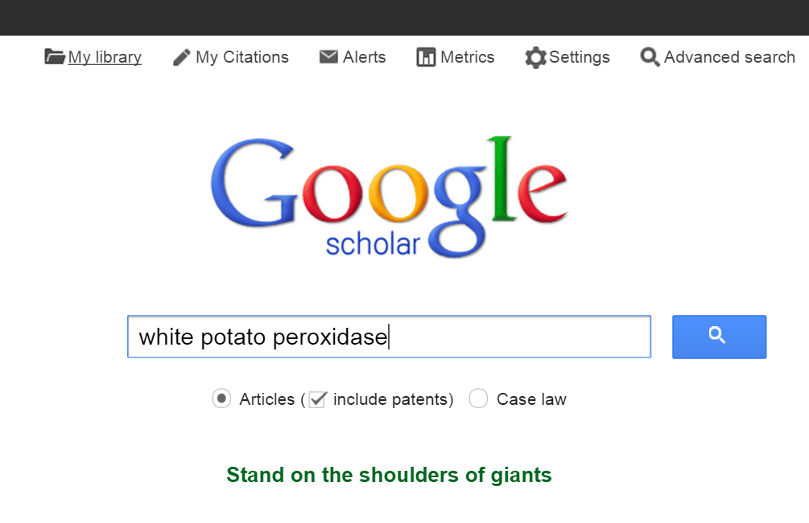
Possible places to find sources
Google scholar (http://scholar.google.com).

Slide 14
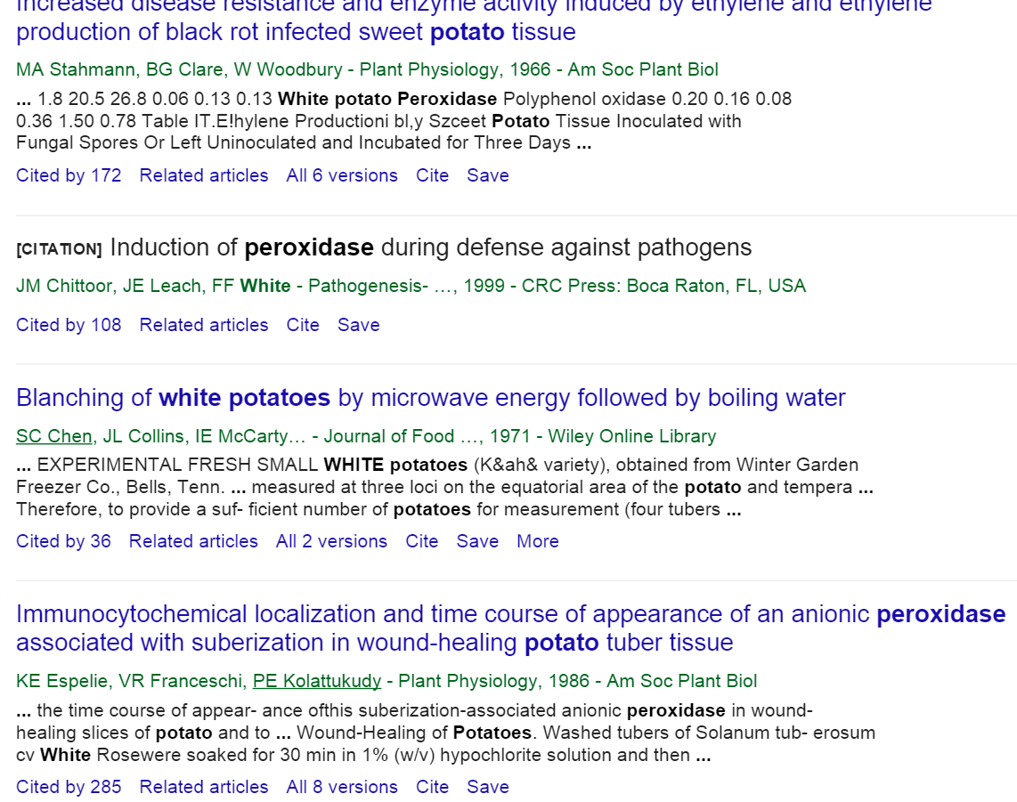
Google Scholar
Scroll until you find a relevant article.

Slide 15

Google Scholar
The link will give
you the abstract
Click Full Text
to read the
article
Some will be free!
Others will have
to be accessed via
the Uindy library.

Slide 16
Today’s activities...

Slide 17
Choosing a study
Lab 3: Hypothesis-Driven Science: Further Inquiry
  Three treatment possibilities for a group of 2:
    pH
      pH 4, 6, 7, and 9
    Temperature
      Cold, semi-cold, room temp, hot
    Salinity
      1%, 2%, 4%, 8%

Slide 18
Activity 1: Reading! ☺
Read over pgs. 39-43 in your lab book
Choose a study as a group, come to me, and tell me that study
Write down the basic treatment on page 48.

Slide 19
Activity 2: Creating an outline
As a group, create an outline for your introduction
  Outline should possess:
    The four-paragraph format,
    Detailed notes about each paragraph (almost sentence-by-sentence)
Show me when you are done.

